Slide 1

Team: WZW
Zach McCown
Team Lead & Programmer
Will Bruzzese
Artist & Programmer
Weston Hollmann
Story Writer & Programmer

Slide 2
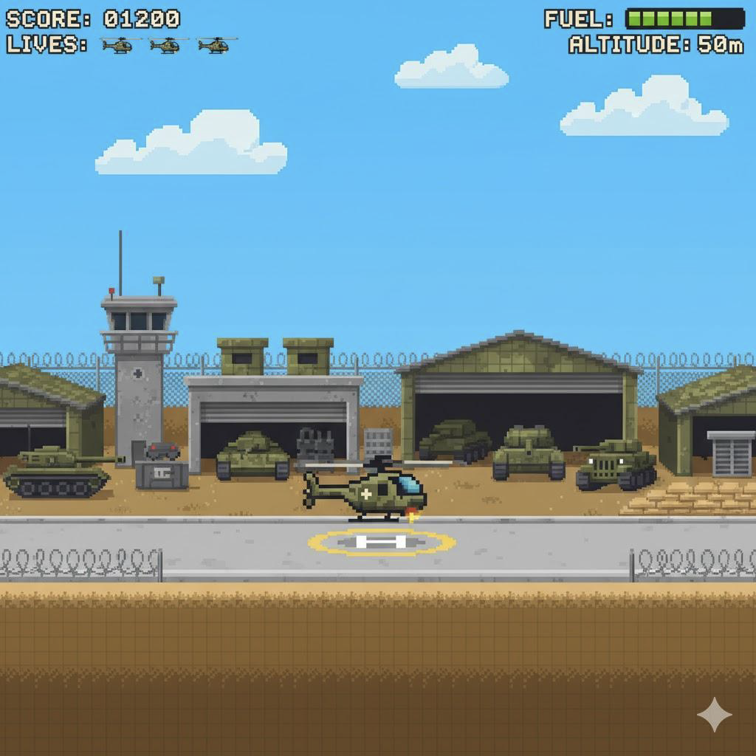
What the Game is About:
Heli Hero is a retro-style, physics-based lander game where players control a military helicopter through war zones to rescue soldiers.
Motivation: Inspired by arcade landers like Jetpack Joyride and Choplifter, we wanted to modernize the genre with pixel-art visuals, and a compelling rescue driven plot.

Slide 3
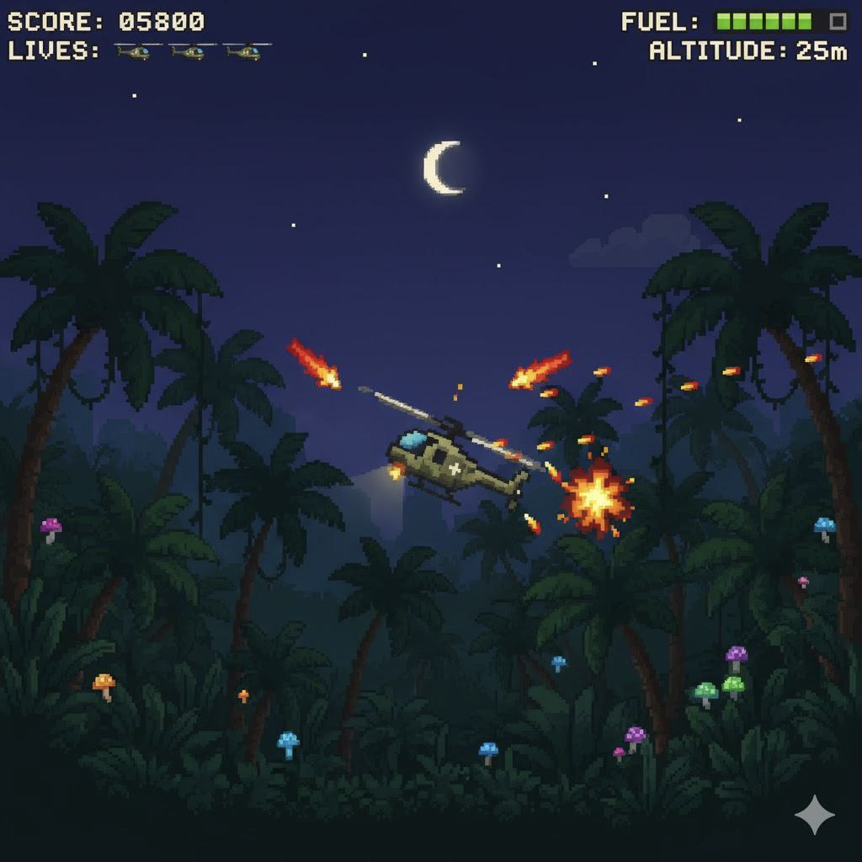
Target Users:
Casual players who enjoy quick, skill-based challenges.
Fans of retro pixel games with 8-bit graphics and sound.

Slide 4
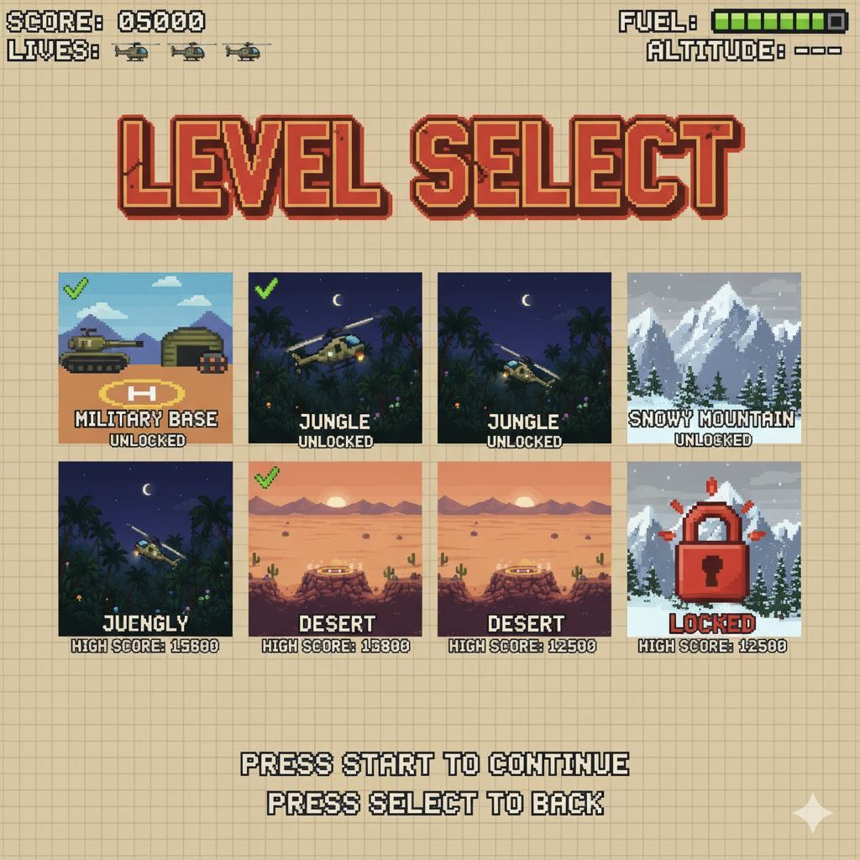
Game World & Context:
Players act as military rescue pilots extracting soldiers from hostile zones.
Missions progress through various enviroments.
The story unfolds through radio transmissions between command center and the pilot.

Slide 5
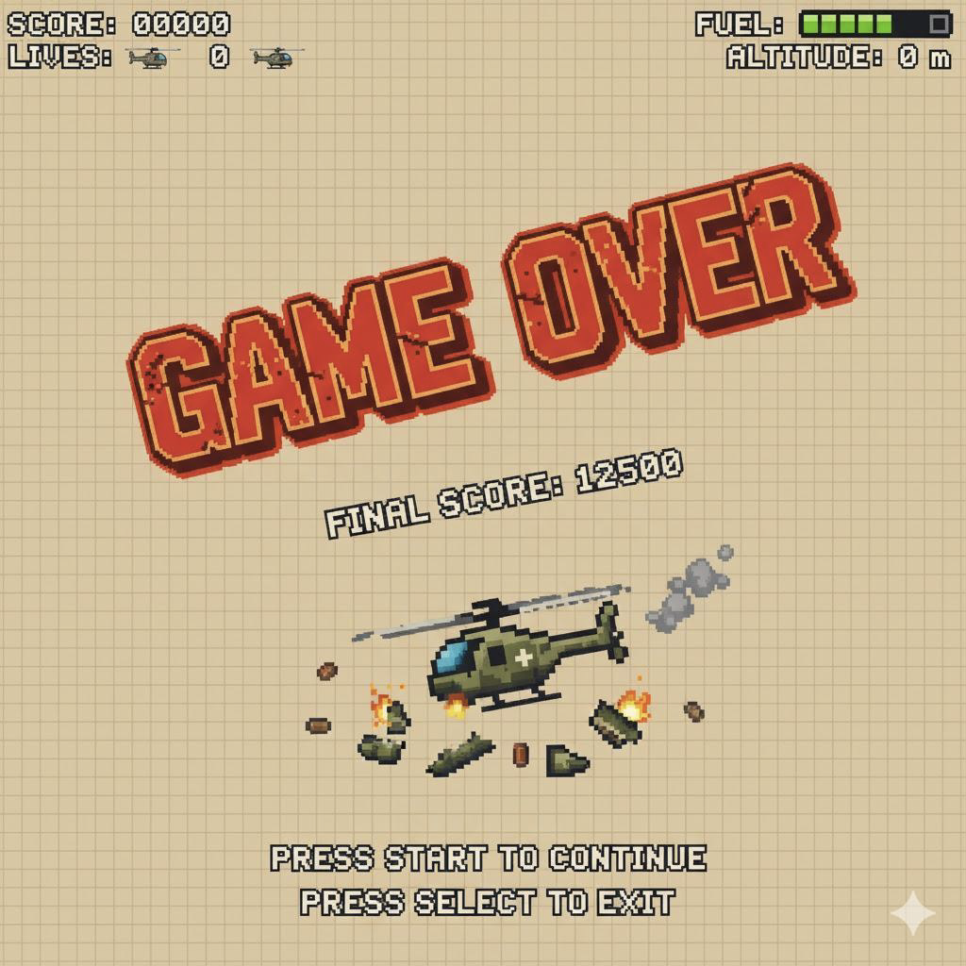
Rules of the Game:
Objective: Land safely on the pad within time and fuel limits.
Successful landing = mission complete.
Crash, run out of fuel, or time = "Game Over."
Scoring is based on speed, accuracy, and fuel reserve.
Levels introduce hazards such as more wind, gunfire, and explosions.

Slide 6
Team Roles & Task Distribution:
Zach McCown – Oversees timeline, manages GitHub repo, implements physics.
Will Bruzzese – Creates art, logo, and assists with programming.
Weston Hollmann – Creates story and dialogue, contributes to level logic.

Slide 7
Questions?

Slide 8
Works Cited:
Images generated by Google Gemini (2025).

